Slide 1

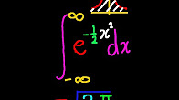
Deep (Easy) Learning
Twitter: @sachinabey
Github: /sachinruk
LinkedIn: /in/sachinabey
URL: tinyurl.com/DLmeetup

Slide 2
Introduction to Keras (Python module)
No mathematics
Notes:
Unfortunately R doesn’t have an extensive deep learning library, H2O is a start. But nowhere near as mature.
Keras is a layer on top of theano/ tensorflow and makes things a whole lot easier than it already is.

Slide 3
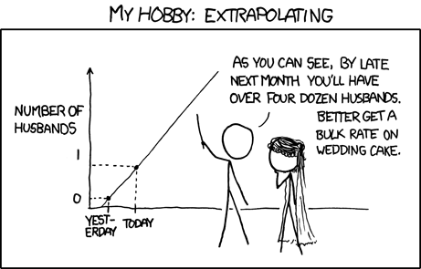
Talk Outline
Intro to NNs
Bayesian NNs
Demos
Notes:
I will run through a quick introduction to Neural nets, I won’t be going through backpropagation. Let me just say that the maths in neural nets/ backprop isn’t too hard. Its just an application of the chain rule in calculus. It’s just that you have to be careful with the matrix multiplications, and things can be tedious when you do convolutional neural nets.

Slide 4
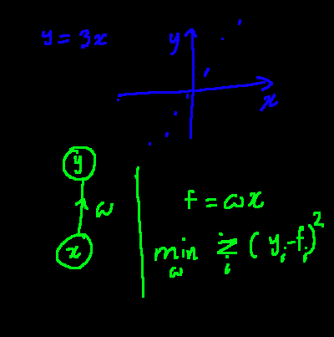
NN Intro
Notes:
This is the zero hidden layer case with one input.
The idea is to change the weights until we minimise a certain loss function. In this case the squared error. I could have easily chosen absolute error

Slide 5
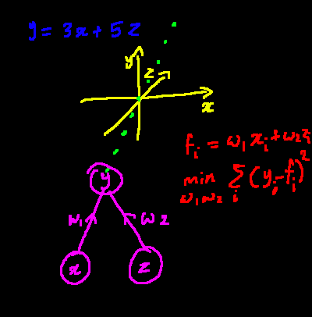
Notes:
Similar thing to before except that we have two inputs.

Slide 6
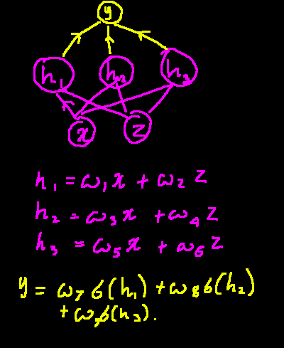
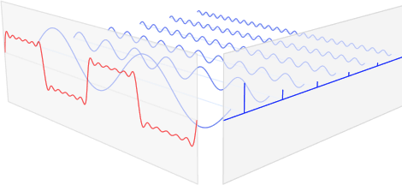
Notes:
It gets interesting when we start having hidden layers and there are these things called activation functions. It could easily be almost any function that you want, but in this case I’ve chosen the sigmoid function (in yellow).
Just want to quickly point out the fourier transform analogy. The aim is to figure out the weights that approximate a repeating step function. The activation function is the “sine” function.

Slide 7
What’s new?
Using stochastic gradient descent
GPUs
Activation functions (eg. RELU)
Some regularisation techniques (eg. Dropout)
Automatic differentiators
NN Architectures (eg. CNNs, LSTMs)
Notes:
Neural Nets have been around since the 70s. So why is there a hype now?
Auto differentiators have been the reason that NNs has gone from an academic curiosity to a widely used tool. I prefer to think of tensorflow/ theano as Auto differntiating tools.

Slide 8
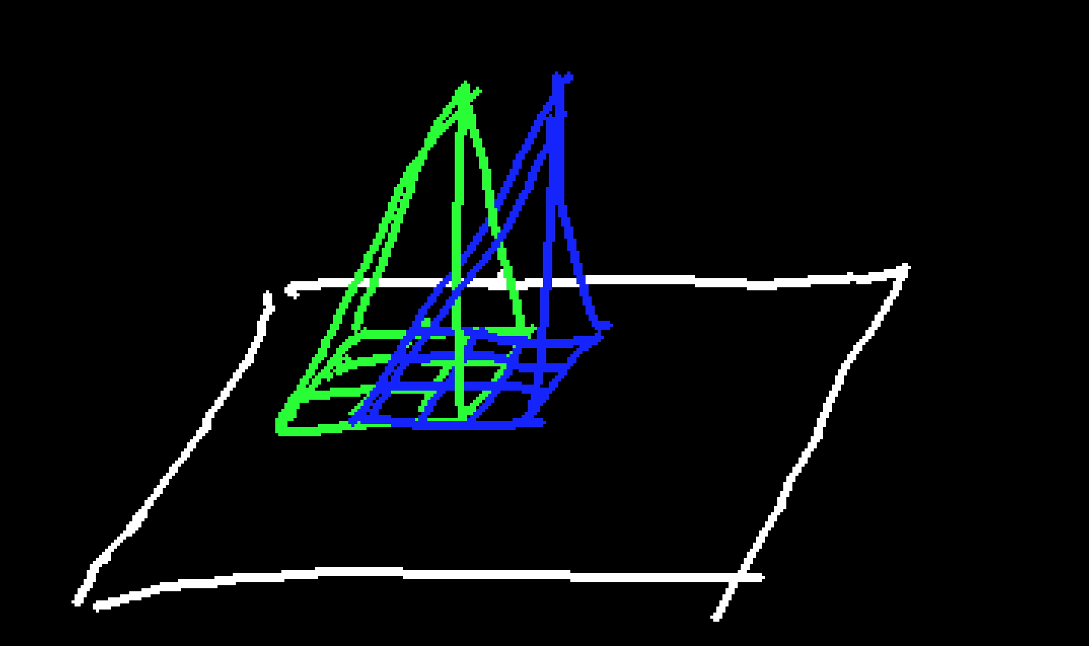
Convolutional Neural Network
Used for images.
Constricted weights
Tied weights
Notes:
A few quick comments on CNNs. First, forget about the convolutional part, its just multiplying things together, second its a special case of NNs where (see above)

Slide 9

LSTM
Long-Short Term Memory NNs
Image Reference: http://colah.github.io/posts/2015-08-Understanding-LSTMs/
Notes:
For time series problems you use recurrent neural nets. Normal Recurrent Neural nets really couldn’t compete that well until LSTMs and GRUs came along.

Slide 10
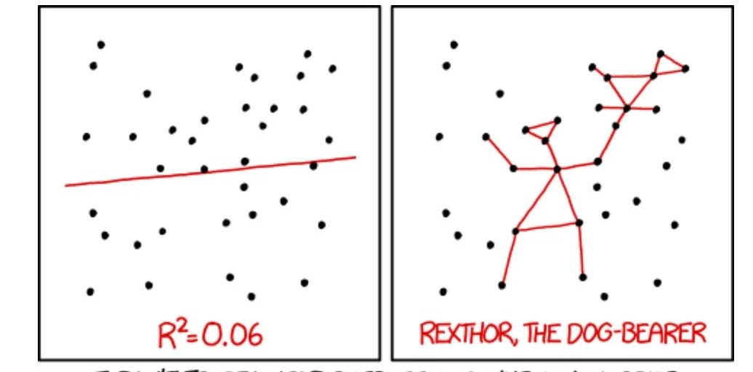
Overfitting

Slide 11
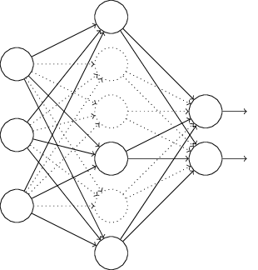
Dropout
Image Reference: http://neuralnetworksanddeeplearning.com/chap3.html

Slide 12
Uncertainty?
Quantile Regression
Use dropout in output http://mlg.eng.cam.ac.uk/yarin/blog_3d801aa532c1ce.html
Notes:
Usually what people want is not uncertainty estimates but confidence intervals, which is better served by quantile regression. If you truly need an uncertainty estimate you can use dropout on the output.

Slide 13
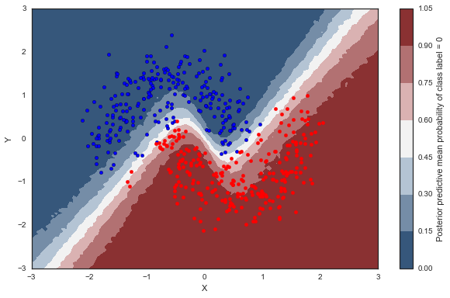
Bayesian Deep Learning
http://twiecki.github.io/blog/2016/06/01/bayesian-deep-learning/
Uses PyMC3 (Variational Inference)
Notes:
Bayesian and machine learning dont belong in the same sentence. Unless you use approximations (Variational Bayes)

Slide 14
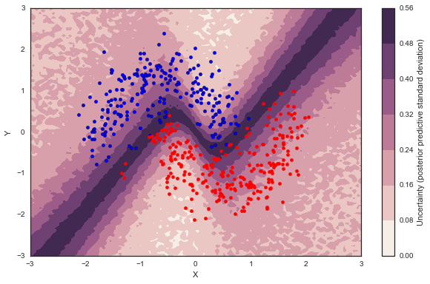
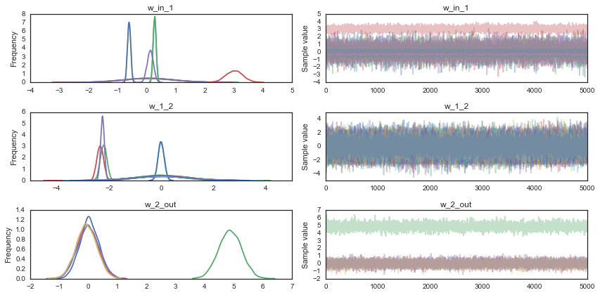
Notes:
You can see that the uncertainty is highest at the decision boundary. There’s also a distribution on the weights if you need.

Slide 15
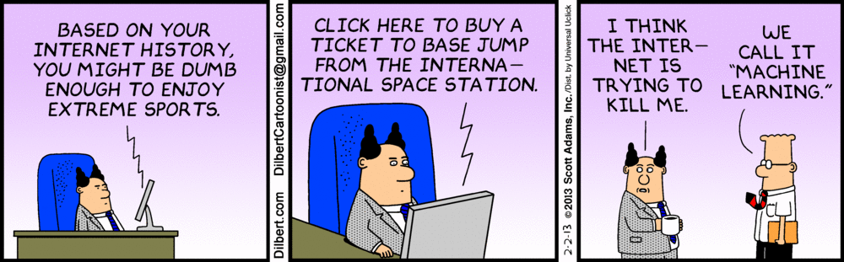
Conclusion: Fire all Data Scientists, Deep Learn everything!!!!
Notes:
We still need to do some level of feature extraction. And sometimes we need to ‘guide’ the algorithm to get reasonable inference, whether it is using cross validation or prior knowledge of the domain.

Slide 16
Demo
https://github.com/sachinruk/PyData_Keras_Talk

Slide 17


Slide 18
References:
https://keras.io/
Amazing explanations/ visualisations on deep/ machine learning: colah.github.io
If you care about the maths, tutorial by Andrew Ng: http://deeplearning.stanford.edu/wiki/index.php/UFLDL_Tutorial
Bayesian Deep Learning: http://twiecki.github.io/blog/2016/06/01/bayesian-deep-learning/
Uncertainty on DL: http://mlg.eng.cam.ac.uk/yarin/blog_3d801aa532c1ce.html

